Slide 1
ELECTRIC FLUX
Created by : Subhan Ghafoor
Roll No#: 25F-CY-063

Slide 2
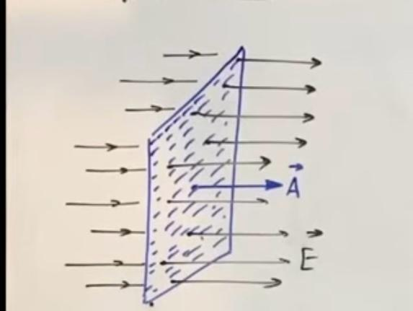
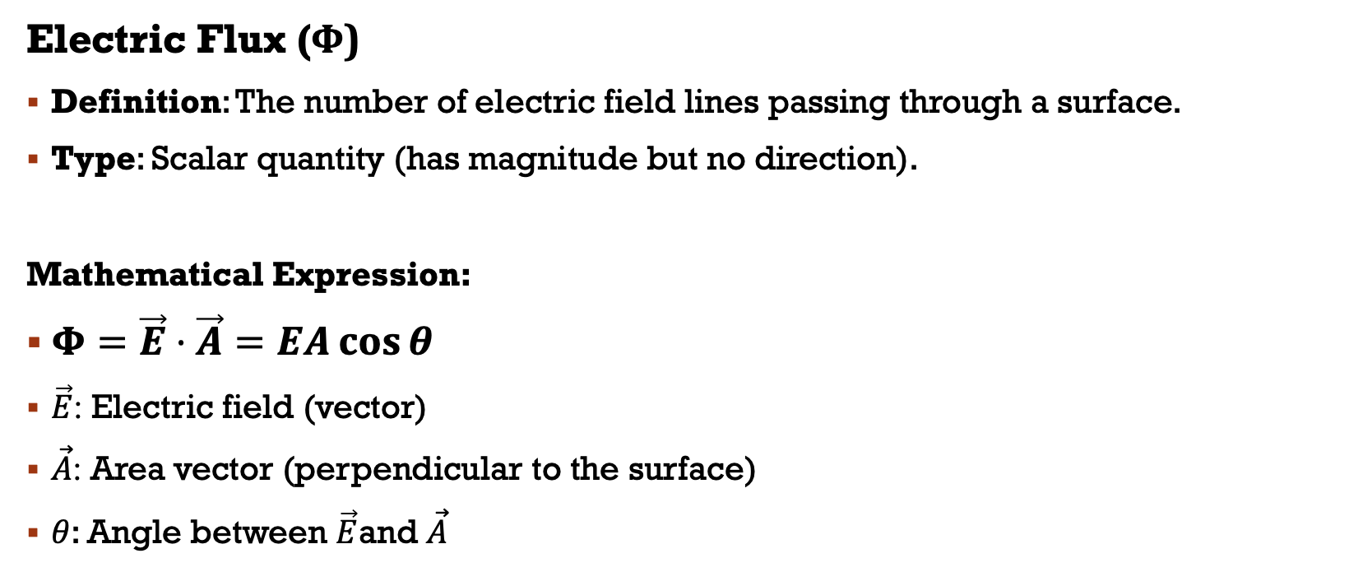
WHAT IS Electric FLUX?
Electric Flux (Φ)
Definition: The number of electric field lines passing through a surface.
Type: Scalar quantity (has magnitude but no direction).
Mathematical Expression:
$Φ=\vec{E}⋅\vec{A}=EA\cos{θ}$
$\vec{E}$: Electric field (vector)
$\vec{A}$: Area vector (perpendicular to the surface)
$θ$: Angle between $\vec{E}$and $\vec{A}$

Slide 3
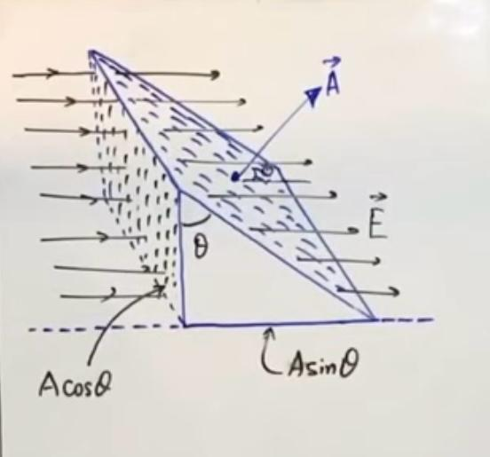
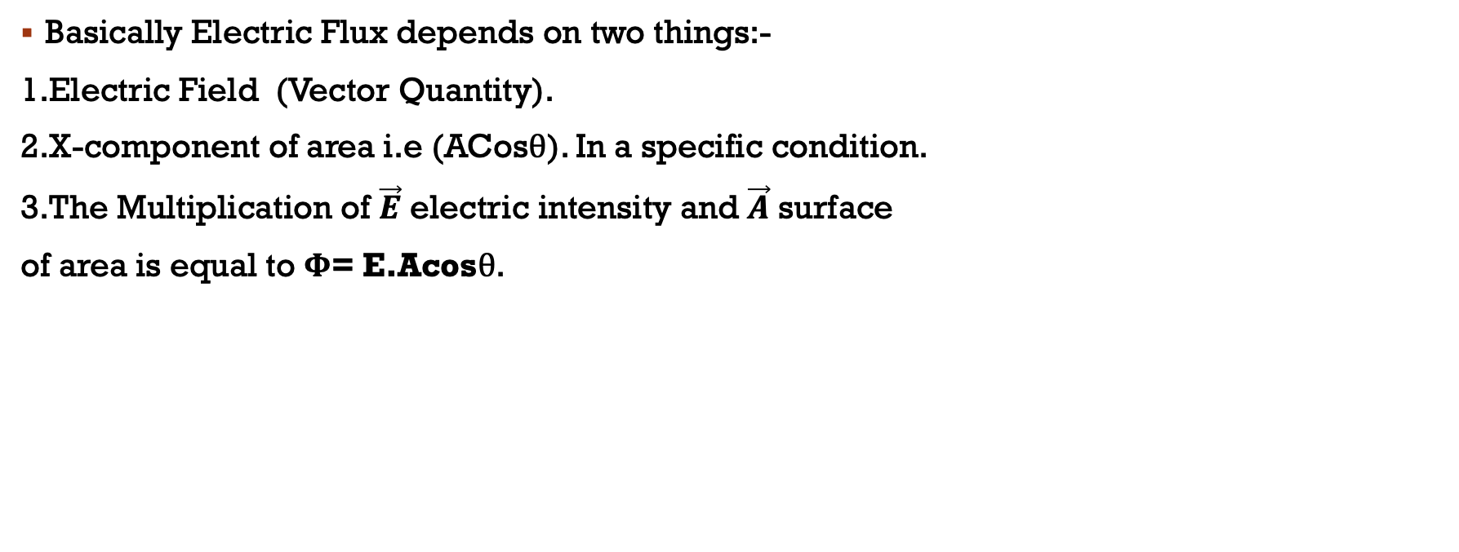
Electric flux depends on what?
Basically Electric Flux depends on two things:-
1.Electric Field (Vector Quantity).
2.X-component of area i.e (ACosθ). In a specific condition.
3.The Multiplication of $\vec{E}$ electric intensity and $\vec{A}$ surface
of area is equal to Φ= E.Acosθ.

Slide 4
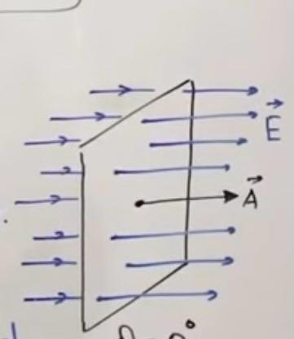
CONDITIONS OF FLUX
Flux can be maximum and either minimum.
It depends on the field lines which are passing
through a particular surface in different conditions.
MAXIMUM FLUX
If the direction of electric field and the direction of area
are same the flux will be maximum.
Φ= EA

Slide 5
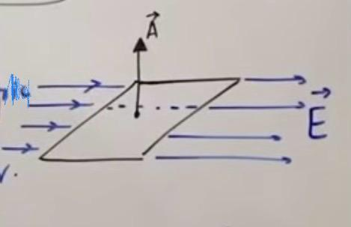
CONDITIONS OF FLUX
MINIMUM FLUX
If the direction of electric field and the direction
of area are perpendicular there will be no flux.
Φ=0

Slide 6
Si unit of flux
The SI unit of Electric Flux is:-
We always derive the SI unit by the formula:-
Φ= EA
Formula of electric intensity is:-
E = F/q = N/C
A = square meter (m²)
The SI unit of Flux will be:-
Φ = N·m²/C

Slide 7
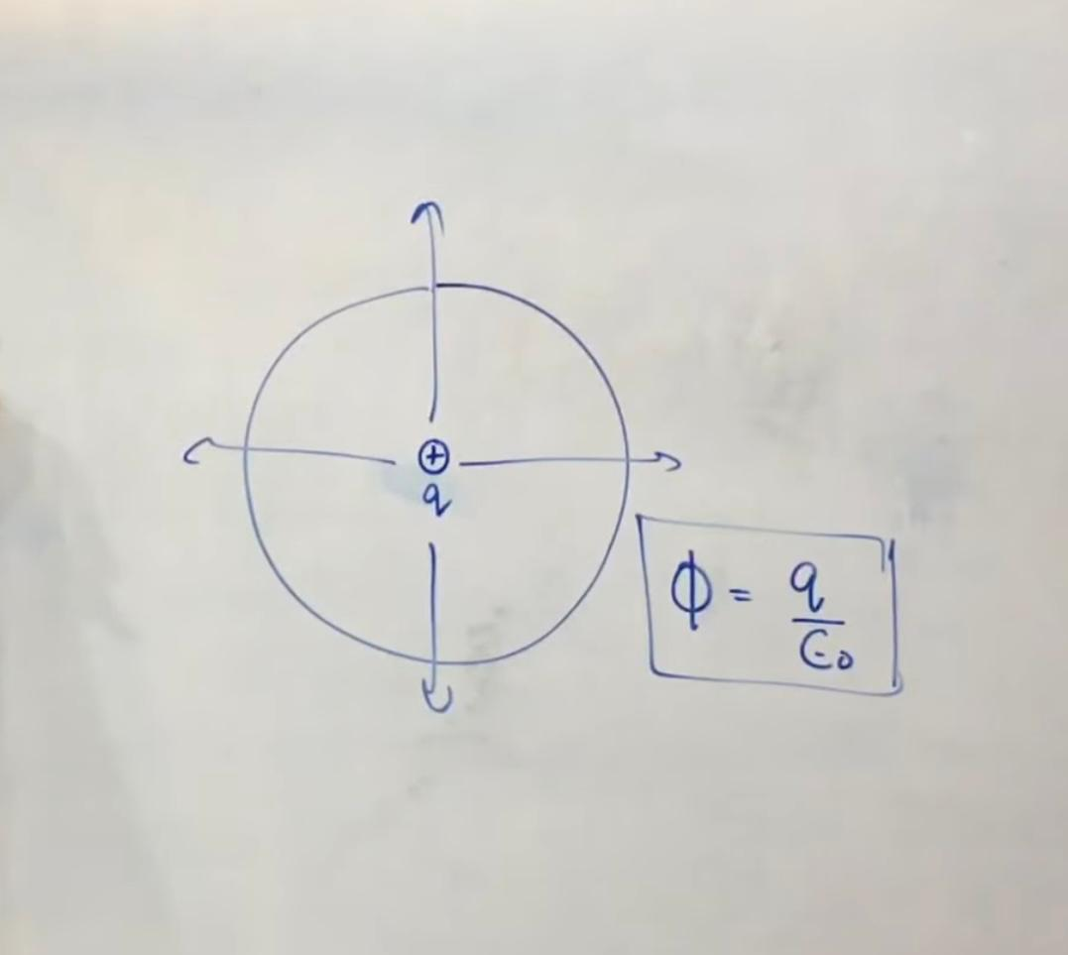
Gauss’s law
Gauss’s law was introduced by Carl Friedrich Gauss.
Introduced in 1835.
This is a electric flux through a closed surface.
This is also called Gaussian’s surfaces.
The surfaces which we imagined around an electric
charge is called Gaussian’s surfaces.

Slide 8
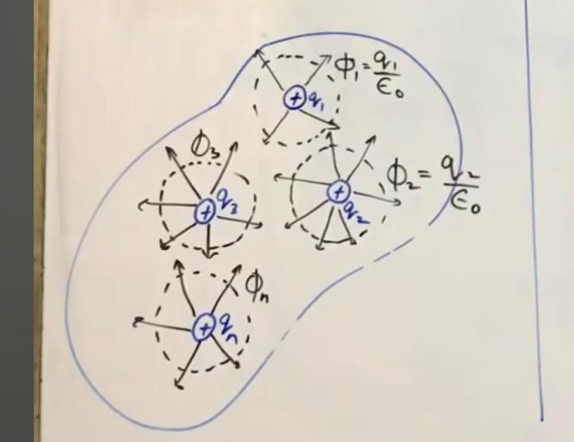
Derivation of Gauss’s lAW
STATEMENT:-
“The net electric flux through a closed surface
is 1/ε₀ times the net electric charge enclosed by
that closed surface”.
The net electric flux through the closed surface
is given by:-
Φnet = Φ1 + Φ2 + Φ3 +………+ Φn.
Φnet = q1/ε₀ + q2/ε₀ + q3/ε₀…….qn/ε₀ .
Φnet = 1/ε₀ [q1 + q2 + q3……..+ qn].
Φnet = 1/ε₀ [net electric charge enclosed by the closed surface].
“Φnet = 1/ε₀ × Q”. A × b , 1/a × c.
“Φnet = Q/ε₀”.

Slide 9
Thank you.....

